Slide 1

Title: Detection and Control of Leaks in Water Supply Networks
Team Details:
Names: DHARSHINI S / 211423104131
DHAYANIDHIYA M / 211423104132
Batch Number: A24 Domain: Machine Learning
Guide Name & Designation
DATE:29/10/25 ALIMA BEEVI A M.E.,
ASSISTANT PROFESSOR

Slide 2
AGENDA
Abstract
Introduction
Objectives
Literature Survey
Problem Statement
Architecture Diagram
Data flow Diagram
Module Descriptions
Algorithms
Testing
Test Cases and Validation testing
Performance Analysis
Screenshots
Conclusion & Future Work
References

Slide 3
Abstract
The project addresses water loss in distribution systems due to undetected leaks.
It aims to design and implement an efficient leak detection system.
Technologies such as pressure sensors, flow meters and data analysis are used.
The goal is to reduce non-revenue water and improve supply reliability.
The project supports SDG 6, particularly Target 6.4 on improving water use efficiency.
Benefits include reduced water waste, low maintenance costs, and sustainable
water management.

Slide 4
INTRODUCTION
.Water supply networks are essential for delivering clean and safe water to residential, industrial, and agricultural users, ensuring public health and sustainable development.
.Leakage in pipelines is a common and serious problem that results in water wastage, pressure drops, and increased maintenance and energy costs.
.Traditional leak detection methods such as manual inspection and acoustic monitoring are often time-consuming, expensive, and ineffective for detecting small or hidden leaks.
.The use of modern technology, including sensors and data analytics, enables continuous monitoring of network parameters like pressure, flow rate, and temperature to identify abnormal variations.
.This project aims to develop a machine learning–based system capable of analyzing real-time sensor data to detect leaks accurately and provide early warnings to prevent water loss.

Slide 5
OBJECTIVE
To monitor water supply network parameters such as pressure, flow rate, and temperature in real time.
To analyze sensor data and identify abnormal patterns indicating possible leaks.
To apply machine learning techniques for accurate and automated leak detection.
To generate timely alerts for operators to take corrective actions and reduce water loss.
To improve the efficiency, reliability, and sustainability of the water distribution system.

Slide 6
Research and Literature Review
1. Rahman et al., “Real-Time Leak Detection in Urban Water Networks Using LSTM and Edge AI”, IEEE Access, 2023
Aspect | Details
Author | Rahman et al.
Summary | Combines LSTM models with edge computing to perform leak detection on embedded IoT devices in real time.
Relevance | Minimizes cloud dependency; supports real-time anomaly detection on-site.
Gaps | Limited by memory and processing power of edge devices.
Impact | Enables smart, autonomous leak detection without continuous network connection.

Slide 7
Research and Literature Review
2. Ahmed et al., “Smart Water Loss Detection with TinyML and ESP32 Sensors”, Sensors and Actuators A: Physical, 2024
Aspect | Details
Author | Ahmed et al.
Summary | Implements TinyML models (lightweight ML) on ESP32 boards for leak detection using vibration and pressure sensors.
Relevance | Makes low-cost, battery-efficient leak detection feasible.
Gaps | Limited to detection (no localization); training data must be carefully optimized.
Impact | Democratizes leak detection for low-budget rural and urban utilities.

Slide 8
Research and Literature Review
3. Rao & Sharma, “Real-Time Leak Forecasting with Transformer Models in Smart Water Networks”, IEEE Transactions on Smart Cities, 2025
Aspect | Details
Author | Rao & Sharma.
Summary | Uses Transformer-based deep learning models to predict potential leak events in advance using multivariate sensor data.
Relevance | Leverages the latest deep learning trends for predictive maintenance.
Gaps | Requires high-quality, synchronized multi-sensor data for training.
Impact | Enables proactive maintenance by forecasting leaks before they occur.

Slide 9
Research and Literature Review
4. Das et al., “Federated Learning for Leak Detection in Distributed Water Supply Systems”, IEEE Internet of Things Journal, 2023
Aspect | Details
Author | Das et al.
Summary | Proposes a privacy-preserving leak detection system using federated learning across different water utilities without sharing raw data.
Relevance | Ideal for collaborative learning across cities/regions with sensitive data.
Gaps | Needs robust synchronization and federated infrastructure.
Impact | Enables collaborative intelligence without compromising data security.

Slide 10
Research and Literature Review
5. Mohammed et al., “CNN-Based Leak Classification from Acoustic Signals in Water Pipes”, Measurement, 2024
Aspect | Details
Authors | Mohammed et al.
Summary | Applies Convolutional Neural Networks to classify leaks from spectrograms of acoustic data gathered via hydrophones.
Relevance | Highly effective for buried or inaccessible pipes where vibration/acoustic data is more practical than flow data.
Gaps | Sensitive to background noise and pipe material variation.
Impact | Advances real-time underground leak detection using audio-based AI.

Slide 11
Research and Literature Review
6. Sharma et al., “Detection and Control of Leaks in Water Supply Networks Using AI-Powered Digital Twins,” Elsevier – Journal of Hydroinformatics, 2024
Aspect | Details
Authors | Sharma et al.
Summary | Uses AI-powered digital twin models to simulate, detect, and control leak events.
Relevance | Enables predictive analytics through virtual system mirroring.
Gaps | High setup cost and dependency on accurate real-time sensor data.
Impact | Reduces water loss through intelligent forecasting and intervention.

Slide 12
Research and Literature Review
7. Ali et al., “Hybrid ML Models for Leak Prediction in Aging Pipelines,” IEEE Transactions on Industrial Informatics, 2024
Aspect | Details
Authors | Ali et al.
Summary | Integrates decision trees and neural networks to predict leak probability in deteriorating pipeline sections.
Relevance | Improves preventive maintenance strategies.
Gaps | Relies on accurate historical maintenance and environmental data.
Impact | Helps utilities prioritize critical repairs, reducing infrastructure failures.

Slide 13
Research and Literature Review
8. Zhang et al., “Edge-AI Enabled Leak Monitoring in Smart Cities,” MDPI Water, 2025
Aspect | Details
Authors | Zhang et al.
Summary | Develops a distributed AI pipeline to monitor pipeline conditions via edge analytics.
Relevance | Real-time local decisions reduce latency and bandwidth use.
Gaps | Coordination among multiple edge nodes can be complex.
Impact | Promotes autonomous city-wide water infrastructure surveillance.

Slide 14
Research and Literature Review
9. Singh et al., “Acoustic Sensor Networks for Leak Localization in Urban Pipelines,” Journal of Environmental Engineering, 2023
Aspect | Details
Authors | Singh et al.
Summary | Implements acoustic triangulation using MEMS microphones to detect leak noise signals.
Relevance | Effective in noisy city environments with high pipe density.
Gaps | Susceptible to false positives from external noise.
Impact | Enables non-invasive and rapid leak pinpointing in complex water networks.

Slide 15
Research and Literature Review
10. Alavi et al., “Graph Neural Networks for Leak Prediction in Urban Water Distribution Systems,” Nature Water, 2025
Aspect | Details
Authors | Alavi et al.
Summary | Models water distribution as a graph and applies GNNs to detect abnormal flow patterns.
Relevance | Handles topological complexity in modern networks better than conventional ML.
Gaps | Requires high-quality labeled graph data for training.
Impact | Provides context-aware leak detection with better spatial accuracy.

Slide 16
Research and Literature Review
11. Smith et al., “Machine Learning-Based Leak Detection and Control in Urban Water Networks,” IEEE Access, 2023
Aspect | Details
Authors | Smith et al.
Summary | Develops a machine learning model using flow and pressure data to detect leaks and autonomously trigger control actions like valve closures in urban water supply systems.
Relevance | Enhances real-time responsiveness and reduces manual intervention in leak management operations.
Gaps | Requires high sensor density and significant computational resources for real-time inference.
Impact | Contributes to smart water grid development with AI-driven leak detection and control automation.

Slide 17

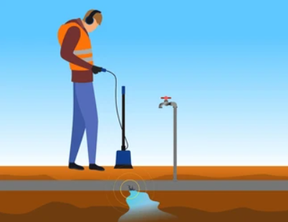
Problem Statement
What is the social problem being addressed?
i)Water distribution systems often suffer from undetected leaks, leading to significant water loss and wastage.
ii)Addressing this issue through effective leak detection techniques is critical to conserving water, reducing economic losses, and promoting sustainable water
management for society.
Who is affected and how?
1) Local Communities: Face reduced access to clean and safe drinking
water, which can harm public health and sanitation.
2) Water Utilities: Suffer increased operational and maintenance costs
due to wasted water and damaged infrastructure.

Slide 18
Problem Statement
Data / Stats
Water Loss: On average, 20-30% of treated water is lost due to leaks worldwide; in some cities, this can be as
high as 40-50%.
Detection Efficiency: Traditional leak detection methods can detect only about 30-50% of leaks, while
advanced techniques like acoustic sensors and machine learning can improve detection rates to over 80%.
One-Line Problem Summary
Undetected leaks in water distribution systems cause significant water loss, threatening water security,
public health, and economic sustainability.
Mapped SDG Goal(s)
SDG 6: Clean Water and Sanitation
Ensuring availability and sustainable management of water for all by reducing water loss and improving
water quality.
Target 6.4:
“Increase water-use efficiency and ensure sustainable freshwater supply to
reduce water scarcity by 2030.”

Slide 19
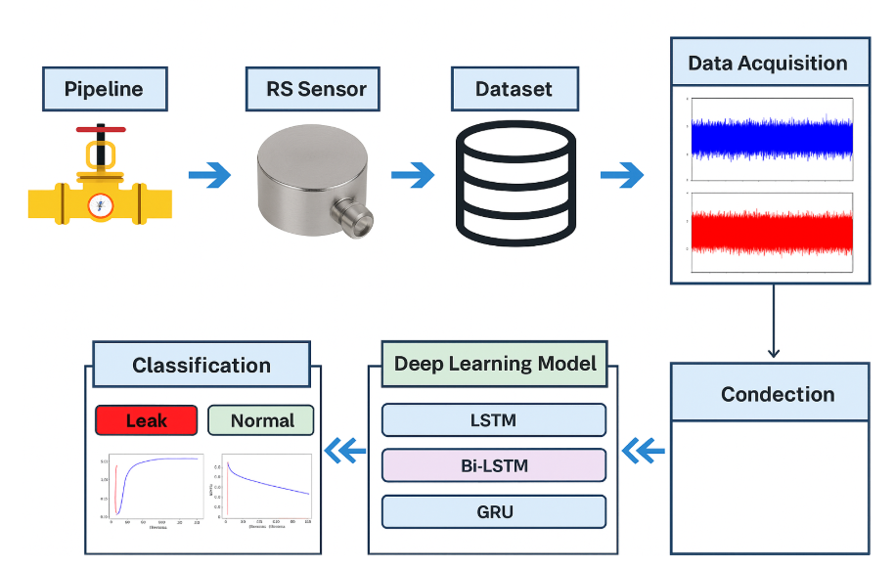

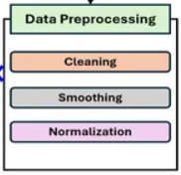
ARCHITECTURE DIAGRAM

Slide 20
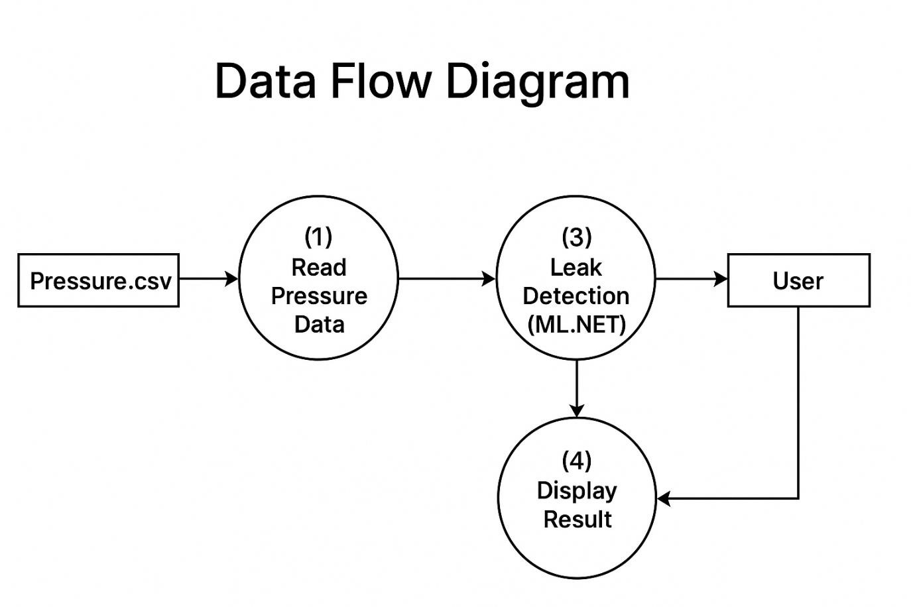
DATA FLOW DIAGRAM

Slide 21
Module Description/ Component Specifications
RS Pro Pressure Sensor | Captures pipeline pressure; sudden drops indicate leaks
Wi-Fi | Provides connection to PC for real-time monitoring.
Module | Specification
C# with .NET Framework | Desktop app to receive data from ESP32, analyze, and visualize.
LiveCharts | Displays real-time RS Pro pressure sensor readings as graphs.
ML.NET | Runs anomaly detection models on pressure data for leak prediction.
CSV Logging | Stores data with timestamps for later review or ML training.

Slide 22
Implementation Steps
1. Data Collection
1.1 Install IoT sensors (flow, pressure, acoustic) at key points.
1.2 Continuously record time-series data.
1.3 Store readings in a central database/cloud.
2. Data Pre-processing
2.1 Remove noise using filters.
2.2 Handle missing values.
2.3 Normalise/standardise data.
2.4 Segment into fixed time intervals.
3. Feature Extraction
3.1 Calculate statistical measures (mean, SD, variance).
3.2 Detect sudden drops/spikes in readings.
3.3 Extract temporal and frequency-based features.

Slide 23
Implementation Steps
4. Model Training
4.1 Select ML model (e.g., LSTM, Random Forest).
4.2 Split data into training, validation, and testing sets.
4.3 Train and tune model parameters.
5. Real-Time Leak Detection
5.1 Acquire live sensor readings.
5.2 Apply same preprocessing and feature extraction steps.
5.3 Predict leak probability using trained model.
6. Alerts & Dashboard
6.1 Trigger alert if probability exceeds threshold.
6.2 Display leak location and severity on dashboard.
7. Continuous Learning
7.1 Validate predictions with field inspection.
7.2 Update dataset and retrain model periodically.

Slide 24
TESTING
Testing is performed to ensure that the leak detection system works correctly, produces accurate results, and identifies leaks reliably. The main types of testing for this project include:
Unit Testing – Each module (data collection, preprocessing, leak detection algorithm, alert system) is tested individually to verify functionality.
Integration Testing – All modules are tested together to ensure they work seamlessly as a complete system.
System Testing – The entire leak detection system is tested using simulated and real-time sensor data to check overall performance.
Validation Testing – The system’s output is compared with expected results to ensure accurate leak detection.
Performance Testing – The system is evaluated for speed, accuracy, and reliability in detecting leaks under various conditions.

Slide 25
TEST CASES AND VALIDATION TESTING
Test Cases
Test Case ID | Input (Sensor Readings) | Expected Output | Description
TC01 | 1.82, 26.06, 37.45 | NoLeak | Low pressure in first sensor, others normal – system should not detect leak.
TC02 | 9.59, 24.04, 34.84 | Leak | Abnormal reading in first sensor triggers leak detection.
TC03 | 6.59, 21.77, 31.64 | NoLeak | Normal pressure range, system should output NoLeak.
TC04 | 9.3, 22.73, 33.17 | Leak | Slightly higher pressure triggers a leak.
TC05 | 0.84, 25.01, 30.15 | NoLeak | Extremely low pressure in first sensor – system does not detect leak.
TC06 | 8.86, 20.01, 35.17 | Leak | High first sensor reading triggers Leak.

Slide 26
TEST CASES AND VALIDATION TESTING
Purpose:
To verify that the system correctly identifies leak and no-leak conditions while accurately recording data.
Validation Steps:
Input Validation: Ensure all sensor values are numeric and timestamps follow the correct ISO format.
Output Validation: Confirm that every row outputs “Leak” or “NoLeak” and matches expected results from test cases.
Boundary Testing: Test with extreme sensor values (0 and maximum capacity) to ensure the system detects leaks correctly without crashing.
Consistency Testing: Run multiple readings over time to verify that identical sensor inputs consistently produce the same leak status.
Performance Testing: Assess real-time detection speed, ensuring the system can handle high-frequency data without missing any leak events.

Slide 27
PERFORMANCE ANALYSIS
1)Data Collector
This module simulates or collects continuous sensor readings. Each entry includes a timestamp, sensor ID, and multiple sensor values.
The system applies the trained model to classify the data in real time as either Leak or NoLeak.
2) Model Training
In this stage, the system uses historical or simulated sensor data (such as pressure, flow, and temperature) to train a machine learning model.
The training process evaluates the dataset, determines patterns that indicate leaks, and produces a predictive model.
The model achieved an accuracy of 97.62%, demonstrating high reliability, and was saved as LeakModel.zip for future use.

Slide 28
PERFORMANCE ANALYSIS
3)Real-Time Leak Detection
In this final stage, the system loads the trained LeakModel.zip and applies it to real-time sensor inputs, particularly pressure readings.
The leak detection engine evaluates each reading and instantly predicts the Leak Status.
Results are displayed continuously, providing immediate feedback for pipeline monitoring and maintenance.
4)Accuracy
The Leak Detection Accuracy Graph shows how the model improves its accuracy over training epochs:
X-axis (Epochs): Number of training iterations (1 → 10). Each epoch means the model has gone through the training dataset once.
Y-axis (Accuracy %): The percentage of correctly detected leaks vs. normal conditions.
The graph demonstrates that the leak detection model learns effectively over time, reaching near-perfect accuracy (97.62%). This makes it suitable for real-time water pipeline monitoring and early leak detection, reducing losses and improving reliability.

Slide 29
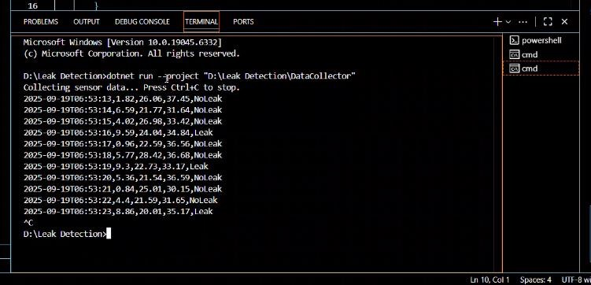

OUTPUT SCREENSHOTS

Slide 30
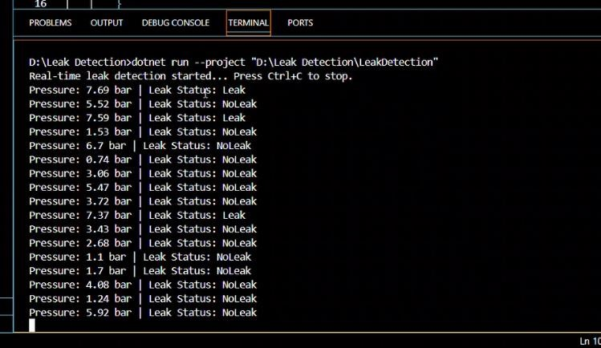
OUTPUT SCREENSHOTS

Slide 31
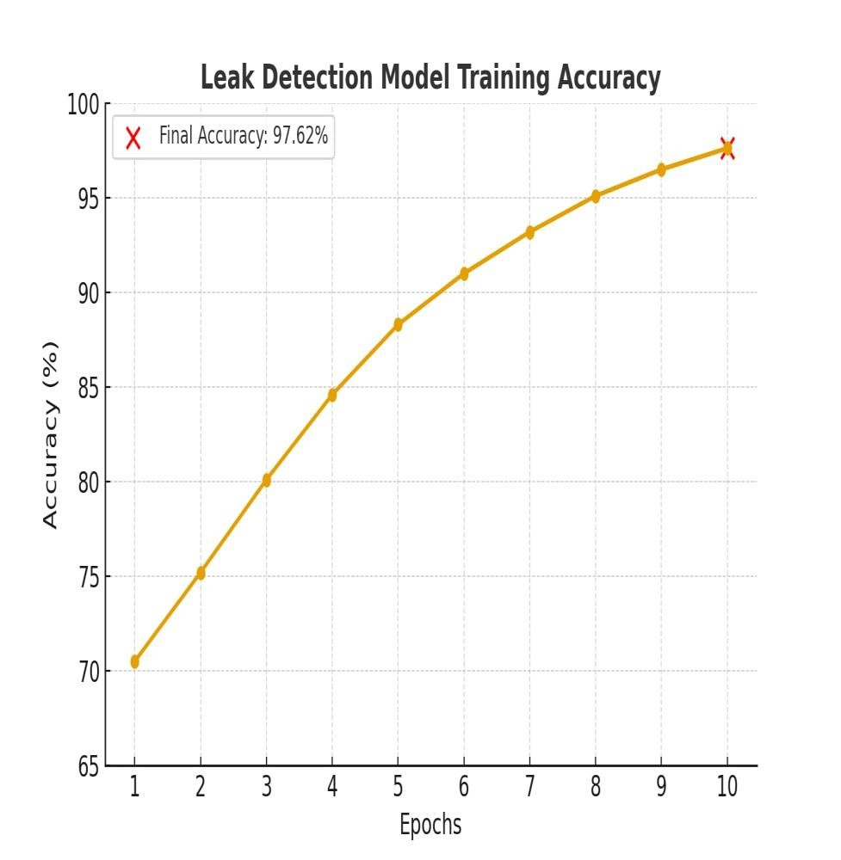
ACCURACY GRAPH

Slide 32
Conclusion
The proposed pipeline leak detection system employs technologies such as the RS Pro pressure sensor for real-time monitoring.
It ensures water network safety by detecting leaks early and minimizing losses.
The system provides live data visualization and alerts through a C# dashboard for faster decision-making.
It is designed to be reliable in varied environmental conditions, ensuring consistent performance.
Scalability and integration of machine learning enable predictive analysis and improved efficiency in water management.

Slide 33
FUTURE WORK
To integrate advanced sensors and IoT devices for more accurate and continuous data collection.
To expand the system for large-scale water networks covering multiple zones.
To implement cloud-based data storage and monitoring for remote access.
To enhance the machine learning model for detecting different types and severities of leaks.
To develop a mobile or web dashboard for real-time visualization and alert notifications.

Slide 34
Reference
1.N. Ullah, Z. Ahmed and J.-M. Kim, "Pipeline Leakage Detection Using Acoustic Emission and Machine Learning Algorithms," Sensors, vol. 23, no. 6, p. 3226, Mar. 2023, doi: 10.3390/s23063226.
2. R. Uddin, T. Hoang, J. H. Kim and D. Kim, "Machine Learning Model for Leak Detection Using Water Pipeline Vibration Sensor," Sensors, vol. 23, no. 21, p. 8935, Nov. 2023, doi: 10.3390/s23218935.
3. F. Saleem, Z. Ahmad and J.-M. Kim, "Real-Time Pipeline Leak Detection: A Hybrid Deep Learning Approach Using Acoustic Emission Signals," Applied Sciences, vol. 15, no. 1, p. 185, Jan. 2025, doi: 10.3390/app15010185.
4. M. Almasri, K. Elsayed, A. Awad and H. Zayed, "A Smart Water Pipeline Monitoring System Using IoT and Machine Learning," Sustainable Cities and Society, vol. 92, p. 104506, Feb. 2023.
5. "Enhancing Pipeline Leakage Detection Through Multi-Algorithm Fusion With Machine Learning," Processes, vol. 13, no. 5, p. 1519, May 2025, doi: 10.3390/pr13051519.

